Slide 1
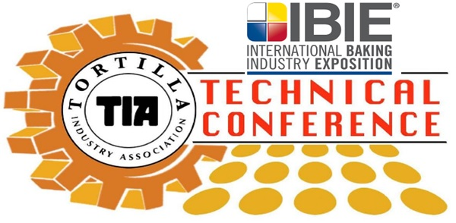
FSMA Compliance – A Wholistic Approach
Len Steed

Slide 2
Who is AIB International?
For 100 years, AIB International has been committed to partnering with our clients to ensure the enjoyment of safe, high-quality food everywhere.
Our global team of food safety and quality professionals in 120 countries helps our customers address virtually every link in their supply chains.
We believe everyone deserves safe, high-quality food, so we are proud to celebrate our 100th anniversary here at IBIE by continuing to share our insights and expertise with the industry.
Notes:
Before I begin, I’d like to offer a brief introduction to AIB International for those who may be unfamiliar.
1. For 100 years, AIB International has been committed to partnering with our clients to ensure the enjoyment of safe, high-quality food everywhere.
2. Through customized Training, Inspections & Consulting, Regulatory and Certification services, our global team of food safety and quality professionals in 120 countries helps our customers address virtually every link in their supply chains.
3. That’s because we believe everyone deserves safe, high-quality food, so we are proud to celebrate our 100th anniversary here at IBIE by continuing to share our insights and expertise with the industry.

Slide 3
Agenda
Food Safety Modernization Act
Understanding the law
Determining Compliance with FSMA
Food Safety Plan
Food Defense Plan
Sanitary transport
Foreign Supplier Verification Program
Developing and evaluating programs for compliance
Maintaining program as changes occur
GFSI and FSMA, do we combine or separate?

Slide 4
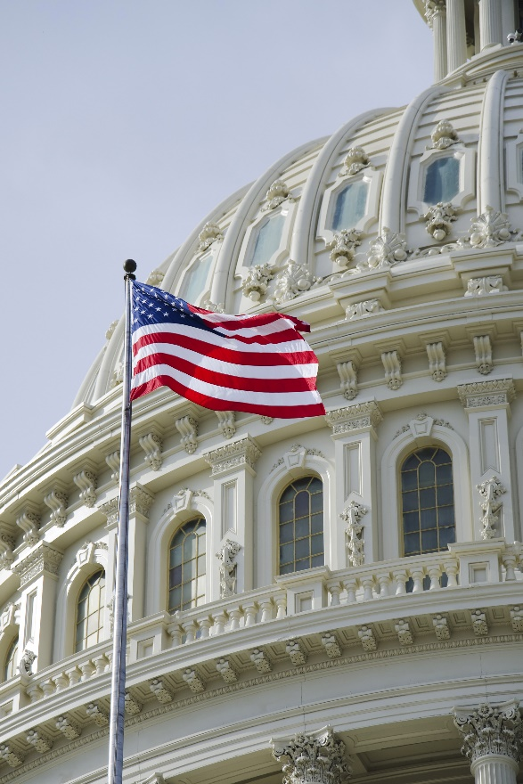
Development of FSMA
During the 111th U.S. Congress, more than 20 bills were introduced to address food safety concerns
Two comparable bills advanced
HR 2749 – Food Safety Enhancement Act
S. 510 – Food Safety Modernization Act
Notes:
Please add a similar picture for Congress.

Slide 5
FSMA Overview
Total of 39 sections
Some sections became effective immediately
Records Access
Mandatory Recall
Bi-Annual Registration
Suspension or Registration
Import Notification
Administrative Detention
Reportable Food Registry
Notes:
Just allude to these, since they will be covered in the next section.
FSMA was signed into law by President Obama on January 4, 2011
• At that time all sections of the Act became law and were considered enforceable
o Some sections did not require any further regulation and were readily understood and enforced
Increase the number of annual inspections
Record access
Suspension of registration
Carry out recalls
Bi-annual plant registration
Import notification
Administrative detention
Reportable Foods Registry
o Some sections, while currently enforceable as written, are subject to further rulemaking in which additional, more prescriptive requirements will be added
The sections that require rules are:
Section 103 – Hazard Analysis and Risk-Based Preventive Controls for Human and Animal Foods
• Proposed rules published January, July, and December 2013
• Supplemental rule published September 2014
Section 105 – Standards for Produce Safety
• Proposed rule published January 2013
• Supplemental rule published September 2014
Section 111 – Sanitary Transport of Food
• Proposed rule published January 2014
Section 301 – Foreign Supplier Verification Program
• Proposed rule published July 2013
• Supplemental rule published September 2014
Section 302 – Voluntary Qualified Importer Program
Section 303 – Authority to Require Import Certifications for Food
Section 307 – Accreditation of Third-Party Auditors
• Proposed rule published July 2013
Proposed as well as supplemental rules represent the FDA’s current thinking on an issue and are not law nor regulation until final publication in the Federal Register

Slide 6
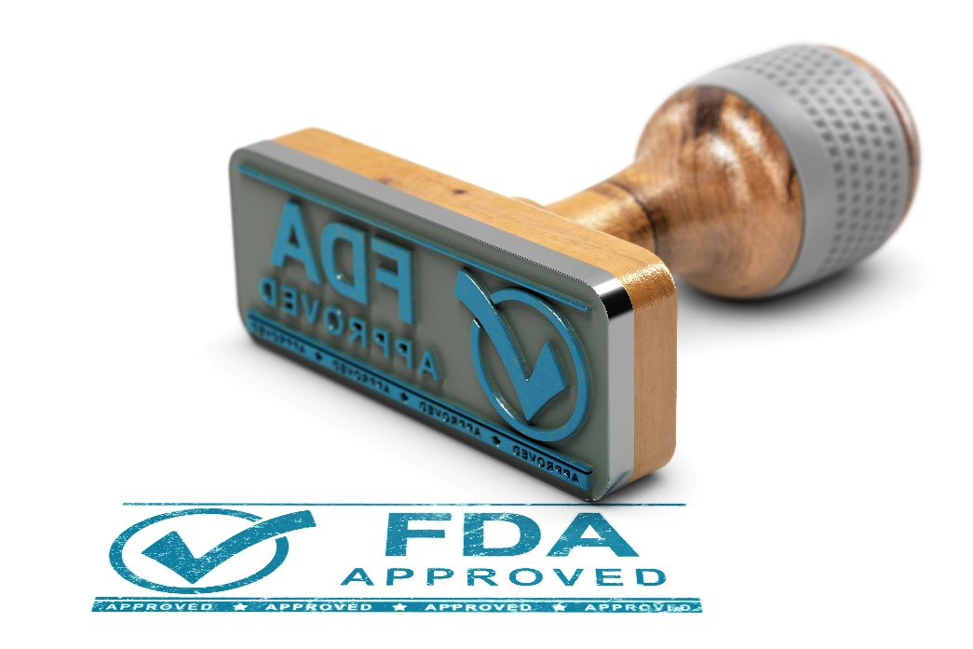
Food Safety Modernization Act
Signed into law January 4, 2011
Large law that required FDA to develop regulations
Gave FDA new regulatory tools for enforcement
Notes:
These are the main foundational regulations generated from FSMA.
FSMA is a large law

Slide 7
Food Safety Modernization Act
FSMA: Food Safety Modernization Act
Food Safety (EMA)
Intentional Adulteration (Food Defense)
Sanitary Transport
Foreign Supplier Verification Program
Produce, and others
Notes:
These are the main foundational regulations generated from FSMA.
FSMA is a large law

Slide 8
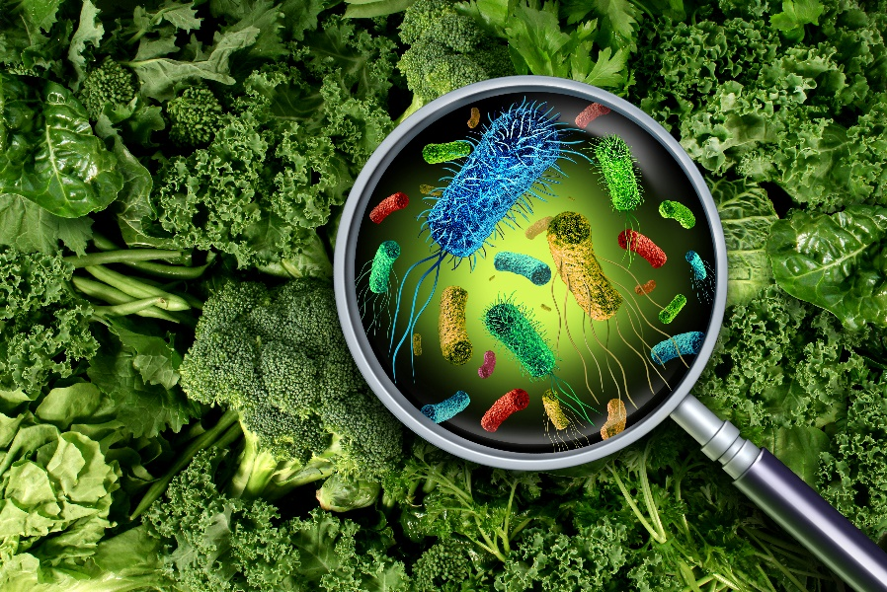
CDC Estimates of Foodborne Illness
CDC estimates that each year roughly 1 in 6 Americans (or 48 million people) gets sick
128,000 are hospitalized
Over 3,000 die of foodborne diseases
Notes:
Significance of foodborne illness from a statistical perspective:
Slides 3-8: Foodborne illness statistics
The information on slides 7-11 come from a comprehensive CDC report entitled Estimates of Foodborne Illness in the United States http://www.cdc.gov/foodborneburden/index.html# . Unfortunately, 2011 was the last time this report was updated. Thus, the specific data on these slides will not be able to be updated. Plus, given the comprehensive nature of this report- these may be the most accurate statistics available.
However, there was another CDC report released Trends in Foodborne Illness in the United States, 2013. http://www.cdc.gov/features/dsfoodsafetyreport/ Highlights:
Salmonella infections decreased by about nine percent in 2013 compared with the previous three years.
Rates remained the same when compared to the longer term 2006-2008 baseline period.
Still well above the national goal for 2020 of four cases per 100,000 people.
Campylobacter infections have risen 13 percent since 2006-2008.
Often linked to contaminated chicken.
Vibrio infections were at the highest level observed since active tracking began in 1996.
Often linked to eating raw shellfish.
Rates of Vibrio vulnificus, the most severe strain, have remained steady.
E.coli infections continue to inch up and the progress noted from previous years has stalled.
Still about 30 percent lower than our FoodNet baseline year of 1996-1998.
Rates of the other foodborne infections tracked have not changed since 2006-2008.

Slide 9
Recalls By The Numbers
Notes:
Nutrient Imbalance 4%
Undeclared Sulfites 2.5%
E.coli 1%
Drug Contamination 1%
Lead .5%
The best resource to update this slide is the 5th Annual Reportable Foods Registry (2014) by the FDA https://www.fda.gov/media/97862/download Highlights:
Unlabeled allergens continue to be the leading cause of recalls and a leading cause of reportable foods for U.S. Food and Drug Administration (FDA)-regulated foods

Slide 10
5 Key Elements of FSMA
402a4
Reaction to Prevention
Reason to believe
Inspection, Compliance, and Response
120 Countries
Imports
State and Foreign offices
Enhanced Partnerships
Notes:
This slide sets to tone for the rest of the course. It summarizes the far reaching implications of FSMA for the food industry word-wide.
It has been 75 years since 1938 and a lot of things have changed in the foods we eat:
Where they come from, the complexity of the food chain, international commerce in foods, processed foods, RTE, new pathogens, allergies, international commerce, refrigerated shipping containers, etc. The legal framework needed to catch up with these world-wide changes.
From reaction to prevention:
402(a)(4) is the past: A food shall be deemed to be adulterated if it consists in whole or in part of any filthy, putrid, or decomposed substances, or if it is otherwise unfit for food.
The failure has already occurred. It is too late. Now there can only be a reaction to correct the failure, penalization, litigation, punishment. This approach to regulation was proven to be not very effective, leading to some 3,000 deaths a year, 278,000 emergency hospitalizations and some 40 million cases of diarrhea. This situation was not deemed acceptable.
402(a)(4) is the future: A food shall be deemed adulterated if it has been prepared, packed, or held under unsanitary conditions whereby it may have become contaminated, or whereby it may have been rendered injurious to health.
The emphasis now is on prevention, by managing the sanitary conditions under which food products are manufactured, held and distributed. Sanitary conditions consists of the 1) physical installations, 2) the activities carried out in the installation, and 3) how/who carries out the activities. These 3 criteria circumscribe the sanitary conditions.
Bottom line: food industry has to shift from reacting to failures to preventing them.
Inspection, Compliance and Response:
Is the mirror image of 402(a)(3) and 402(a)(4). “Credible and verifiable information” is the criteria used to demonstrate 402(a)(3), that is a food product is adulterated, i.e., the failure has occurred. While “Reason to believe” is the equivalent of “unsanitary conditions” which may result in an adulteration, and such conditions are simply not acceptable, i.e., emphasis on prevention.
This has huge implications for how the food industry develops, implements and manages the cGMPS and food safety programs, and even more so on how the FDA will approach its inspections in the future. That is, the FDA will put tremendous emphasis on the sanitary conditions of the installation mentioned above, plus the documentation associated with the manufacturing of the product.
Imports:
This is the biggest and most far reaching change in FSMA. It reflects the reality that 1) there are more food plants outside the USA exporting food to the country then there are food plants inside the US, 2) that many food products come from countries with underdeveloped food safety laws and institutions, and 3) for some food products, most of it is imported.
This section of the law makes the importer in the US, responsible for the safety of the food as well as the sanitary conditions under which it was manufactured in the foreign country. In other words, all importers of foods regulated under the FDA will have to establish and manage a supplier control program, called a Foreign Supplier Verification Program.
Imagine, more than 300,000 foreign facilities and tens of thousands of importers in the US.
Enhanced partnerships:
Realizing that the USA depends on the world to feed itself, the FDA needs to put “boots on the ground” in order to improve the institutionally of food safety in exporting countries. This includes harmonizing laws and regulations, strengthening counterparts to provide equivalent services in those countries, and recognize those with equivalent or comparable food safety systems, such as New Zealand, the only one so far.
Bottom line: assist exporting countries in being more effective in prevention.

Slide 11
Wholistic Approach
Notes:
Now lets look at how we can approach building our programs using a wholistic approach. Or is we are re-analyzing our plan how to consider doing this in a wholistic approach.

Slide 12
Question?
What are some of the new regulatory powers that were granted to the FDA under FSMA?
Notes:
But first a question. (Ask the class this questions to facilitate discussions)

Slide 13
Answer!
Mandatory Recall
Administrative Detention
Record Access
Suspension of Registration
Reason to Believe
Notes:
Here are some answers if not covered by the class.

Slide 14
Determining Compliance
101-Records Access
102-Registration of Food Facilities
206-Mandatory Recall
207 Administrative Detention
211- Reportable Food Registry
304-Prior Notice of Imported Foods
Notes:
1st step in taking a wholistic approach to either developing a FSMA program or re-evaluating one is determining which FSMA sections and or regulations apply to our facility and or business. Listed on this slide are the main sections of the FSMA outside of the new regulations that can and may impact how a facility develops or should consider when re-evaluating their programs. Understanding how FSMA enhanced these requirements or added new regulatory powers to the FDA can allow you to account for these into your programs.
Discuss each one and ask how these items was considered in current programs. Additionally to start the discussion you may need to pose some situations experienced in the field.

Slide 15
Determining Compliance
103-Preventive Controls (Human or Animal)
105-Produce Safety (Growers)
106-Intentional Adulteration (Human)
111-Sanitary Transport (Human or Animal)
301-Foreign Supplier Verification Program (All)
302-Voluntary Qualified Importer Program
307-Accreditation of Third-Party Auditors
Notes:
1st step in taking a wholistic approach to either developing a FSMA program or re-evaluating one is determining which FSMA sections and or regulations apply to our facility and or business. Listed on the slide are the 7 key regulatory programs developed by the FDA from various sections within the FSMA. Compliance with these 7 regulatory programs will depend on several factors, such as the products produced, location of suppliers, and others. Within determining compliance once a regulatory requirement is identified, you then need to determine when is this program required to be implemented.
Ask questions on if facilities need to comply these programs. How did the prepare to comply with the requirements. Did the combine or take an individual program approach.

Slide 16
Developing and Evaluating Programs
Understanding Requirements
Training
Collaboration
Guidance and Regulatory Documents
Industry Updates
Notes:
Once you have determined what sections of FSMA applies to your facility or company the next step should be is to understand what those sections requirements are and how they apply to your facility. This will require training and education for those staff members that will develop or re-evaluate your programs. It will also require collaboration. This will include team members such as Food safety or Food Defense team members. It may also included elements from the business or corporate level. Ensure that the team or responsible individual has the latest regulations and or guidance documents of those sections that apply to your facility.
If you already have these programs established and you are conducting a re-analysis these things will still apply. New guidance from FDA on regulations may require some adjustments to our programs. The personnel involved in developing our original program may have moved on so training of new personnel on the requirements may be required. With those new potential changes it may be necessary to review current programs and make small adjustments. So time and resources may be required as well.

Slide 17
Developing and Evaluating Programs
Current Program and Policy Review
Includes review of prerequisite programs
Policies
Programs
SOPs
Time
Resources
Notes:
Next you should evaluate your current programs and or policies that are already in place for your facility. Reviewing these prerequisite programs and keeping in minds the regulatory requirements or FDA’s new regulatory powers can assist in updating these programs prior to developing or reviewing the hazard analysis, vulnerability assessments that are required from most of the regulations. This will take time and require resources so planning for these things can assist this process.
If you already have these programs established and you are conducting a re-analysis these things will still apply. New guidance from FDA on regulations may require some adjustments to our programs. The personnel involved in developing our original program may have moved on so training of new personnel on the requirements may be required. With those new potential changes it may be necessary to review current programs and make small adjustments. So time and resources may be required as well.

Slide 18
Developing and Evaluating Programs
Conducting or Reviewing Assessments
Food Safety (Food Fraud, Transportation)
Intentional Adulteration
Foreign Suppliers and Raw Materials
Notes:
Like we mentioned earlier, All FSMA regulations are based off prevention. So most of the FSMA driven regulations require an assessment. If conducted the right way some of the assessments can be combined and still cover the requirements. Where others you may want to keep separate. For example Preventive Controls for human and or Animal food require a hazard analysis, Evaluating based on Likelihood vs Severity and considering B,C,P, R and EMA (Food Fraud with a Food Safety issue) For Sanitary Transport an assessment for transporting safe food is required depending on the product. This could be captured in the food safety hazard analysis. If you are the direct importer and are obtaining products from outside the U.S. an assessment of the ingredient and supplier is required, this could be combined and captured within the hazard analysis.
If you are re-analizing these assessments you need to understand the requirements and need to ensure they are accurate. Questions to consider include, have we included a new product? Process? Any Significant Changes? And if needed make adjustments or re-assess these new things and include them in the current program.
However, it is not recommended to combine Intentional Adulteration. This assessment is different, has different requirements, and may not be something you want to share with outsiders.

Slide 19
Developing and Evaluating Programs
Developing, Implementing, or Reviewing Controls
Preventive Controls (CCPs)
Mitigation Strategies (IA)
Management Components
Monitoring
Corrective Actions (Corrections)
Verification
Sometimes Validation
Notes:
Once the assessment or assessments are completed and you have identified those significant hazards, or vulnerabilities you need to implements controls to reduce or eliminate those significant issues. In most cases controls established is based on your facility and products produced. There is no defined requirements for what controls are required to look like. However, within the procedure it needs to justify how this control will reduce or eliminate the issue identified. Depending on the regulation there are specific requirements for how management components are reviewed and documented. In general management components include Monitoring, corrective actions, and verification. Some require validation.
If re-analyzing your plan the same above will apply. Does our controls meet regulatory requirements? Have we justified all our decisions? Are we able to follow our plan?

Slide 20
Developing and Evaluating Programs
Re-Analyzing
Minimum requirements
Significant Change
Corrective Actions
Documenting reviews
Document reviews
Re-signing and dating the Plan
Only required if changes are made
Notes:
If you are re-analyzing your plans and or programs you need to understand the minimum requirements for when re-analysis is required. For most programs this is every three years. Again this is the minimum. There may be times when you are required to re-analize more frequently. Such as when a significant change occurs in your facility. This could be a new product, supplier, raw material. It also could be new equipment or construction work that could create food safety issues. You are also required to re-analize when you have corrective actions. This would only require a re-analysis of that preventive control or mitigation strategy.
It is suggested to document your reviews. This way you can demonstrate this occurs when required. Developing a written procedure and who needs to be involved could assist in ensuring this process is followed.
When changes are made the plan needs to be re-signed and dated by the Sr. person in the facility.

Slide 21
Developing and Evaluating Programs
Documenting reviews
Written procedure
Proof review occurred
Re-signing and dating the Plan
Only required if changes are made
Maintaining discontinued plans
Notes:
The regulation does require review of your plan when things change or controls are not maintained. Currently, how do you do this?
It is suggested to document your reviews. This way you can demonstrate this occurs when required. Developing a written procedure and who needs to be involved could assist in ensuring this process is followed.
When changes are made the plan needs to be re-signed and dated by the Sr. person in the facility. Plans need to be maintained for two years after they are discontinued.

Slide 22
Maintaining Your Programs
Program Update or Review
New products
New equipment
Construction
New Suppliers
Plan review
Implement changes
Documentation

Slide 23
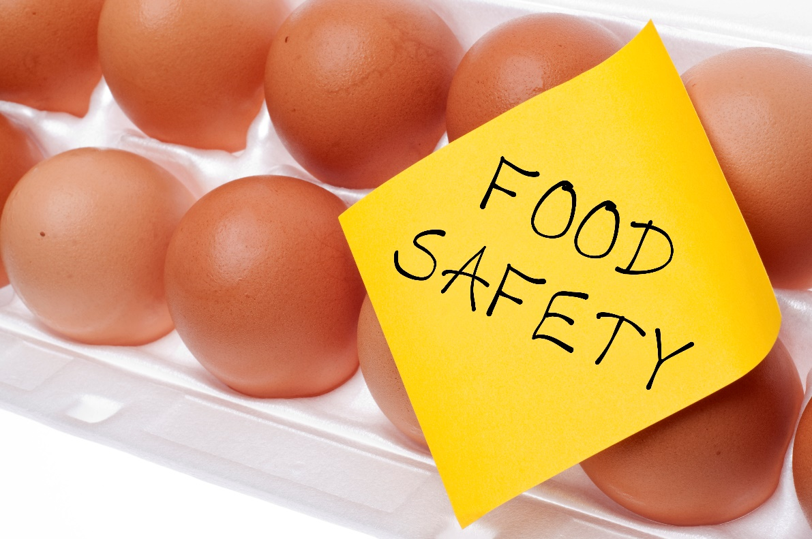
Question?
What are the current ways you maintain your food safety programs?

Slide 24
Answer!
There is no right answer
Each facility or company will do this in a different way
As long as you can demonstrate this process is done and meets regulatory requirements you can choose

Slide 25
Combining GFSI and FSMA
Global Food Safety Initiative
Food Safety
HACCP and Regulatory Compliance
Food Fraud
All types (GFSI)
EMA (FDA)
Food Defense
Basic requirements (GFSI)
Specific requirements (FDA)
Notes:
Combining GFSI and FDA can occur. However, understanding they have drastic differences is important when building your programs.
GFSI requires HACCP and all the steps that go with it. FDA requires a Food Safety Plan that goes beyond what HACCP requires. Additionally HACCP requires some elements that the food safety plan recommends but is not required like flow diagrams and product descriptions.
Food Fraud is very simple under the FDA requirements you only need to assess food fraud with a food safety issue from a known historical view. GFSI requires an in depth review and assessment for all types of food fraud to include fraud of your own products.
Food Defense under GFSI is basic and general. You just need to conduct an assessment (no specific requirements) and if significant vulnerabilities are identified develop a mitigation strategy plan. FDA has some very specific requirements in what has to be captured in a vulnerability assessment as well as mitigation strategies and the management components that goes with them.
Instructor can highlight the differences.

Slide 26
Combining GFSI and FSMA
Global Food Safety Initiative
Supplier Requirements
Foreign Suppliers simplified
Sanitary Transport
Industry Best Practices (GFSI)
Specific Requirements (FDA)
Notes:
GFSI uses basic supplier requirements. But if hazards are only able to be controlled by the supplier FDA has some specific program requirements that need to be met. This also applies to the Sanitary transport regulation.
Instructor can highlight the differences.

Slide 27
Combining GFSI and FSMA
The choice is yours
Ensure requirements are covered
Combine or separate
Demonstrate Compliance

Slide 28
Summary
Food Safety Modernization Act
Discussed the law
Understand regulatory compliance with FSMA
Food Safety Plan
Food Defense Plan
Sanitary Transport
Foreign Supplier Verification Program
Ways to develop and evaluate programs for compliance
Maintaining program as changes occur
GFSI and FSMA combine or separate

Slide 29
Questions

